Slide 1
Adatscience Technical interview
-- Solution by Tuhin pal

Slide 2
Data description
The given dataset has data about Movie information ranging from year 1960 to 2015. The data column description is as below:
Id : unique ID mapped to each movie
Imdb_id : unique imdb_id is mapped to each movie
Popularity : popularity index mapped to each movie ranging from 0 to highest as 32.99
Budget : Total budget spent on each movie
Revenue: Total revenue generated from each movie
Original_title: Name of the movie
Cast: All the cast member(Actors, actresses etc.) given

Slide 3
Data description_continued
8. homepage: Homepage or website of the movie
9. director: Director’s Name of the movie
10. tagline : Tagline for each movie
11. keywords : Keywords used to describe each movie
12. overview : Brief description about the movie
13. runtime : Runtime of the movie in minutes
14. genres : Genre of the movie
15. production_companies : Production house of the movie that has spent money on making it.
16. release_date : Release date of the movie

Slide 4
Data description_continued
17. vote_count : Count of votes given review/vote for the movie.
18. vote_average : vote/review average of the movie
19. release_year : Release year of the movie
20. budget_adj : Adjusted budget amount
21. revenue_adj : Adjested revenue amount
22. genres1 : Split genre column – 1st genre type
23. genres2 : Split genre column – 2nd genre type
24. genres3 : Split genre column – 3rd genre type
25. genres4 : Split genre column – 4th genre type
26. production_companies1 : Split production_companies column – 1st type

Slide 5
Data description_continued
27. production_companies2 : Split production_companies column – 2nd type
28. unnamed_0 : Split production_companies column – 3rd type
29. unnamed_1 : Split production_companies column – 4th type
30. unnamed_2 : Split production_companies column – 5th type

Slide 6
Exploratory data analysis
Load necessary libraries
Load the data
Describe the data
Genre and production_companies have extended columns. Hence removed columns : 'genres1', 'genres2', 'genres3', 'genres3.1', 'genres4', 'production_companies1', 'production_companies2', 'Unnamed: 28', 'Unnamed: 29', ‘Unnamed: 30‘
Change the release_date column into Date type for further analysis
Column wise NA values as below:
Imdb_id=10
Cast=76

Slide 7
Exploratory data analysis_continued
Column wise NA values as below:
Homepage=7930
Director = 44
Tagline = 2823
Keywords = 1493
Overview = 4
Production_companies = 1030
As NA values are only in Categorical variables hence replacing the values with "Not mentioned".
Extract weekday from Release Date column and create a new column
Create a new column extracting month from Release Date column
Split Genre column using delimiter

Slide 8
Exploratory data analysis_continued
Creating column types for genre types
Split Production Companies column using delimiter and creating new columns
Remove less important columns : ‘genres’,’production_companies’,’id’,’imdb_id’
Check duplicate values.
Count=1
Column index_no = 2090
Drop the duplicate row
Print/Evaluate top revenue generating 3 Production companies
For Production company_1 : ‘Paramount Pictures’, ‘Universal Pictures’, ‘Walt Disney Pictures’
For Production company_2 : ‘Warner Bros.’, ‘Twentieth Century Fox Film Corporation’, ‘Amblin Entertainment’

Slide 9
Exploratory data analysis_continued
Creating column types for genre types
Split Production Companies and genre column using delimiter and creating new columns
Remove less important columns : ‘genres’,’production_companies’,’id’,’imdb_id’
Check duplicate values.
Count=1
Column index_no = 2090
Drop the duplicate row
Print/Evaluate top revenue generating 3 Production companies
For Production company_1 : ‘Paramount Pictures’, ‘Universal Pictures’, ‘Walt Disney Pictures’
For Production company_2 : ‘Warner Bros.’, ‘Twentieth Century Fox Film Corporation’, ‘Amblin Entertainment’

Slide 10
Exploratory data analysis_continued
Print/Evaluate top revenue generating 3 Production companies
For Production company_3 : ‘Warner Bros.’, ‘Dune Entertainment’, ‘Heyday Films’
For Production company_4 : ‘Warner Bros.’, ‘Relativity Media’, ‘Syncopy’
Print/Evaluate top revenue generating 3 Genre
For Genre_type1: ‘Action’, ‘Adventure’, ‘Comedy’
For Genre_type2: ‘Adventure’, ‘Action’, ‘Drama’
For Genre_type3: ‘Thriller’, ‘Science Fiction’, ‘Family’
For Genre_type4: ‘Thriller’, ‘Science Fiction’, ‘Family’
For Genre_type5: ‘Thriller’, ‘Family’, ‘Fantasy’
Top 3 months in which movies have released and generated most revenue : ‘December’, ‘June’, ‘May’

Slide 11
Exploratory data analysis_continued
Top 3 weekdays on which movies have released and generated most revenue : ‘Friday’, ‘Wednesday’, ‘Thursday’
Top 3 months in which movies have released and received most review : ‘December’, ‘September’, ‘November’
Top 3 weekdays on which movies have released and received most review : ‘Wednesday’, ‘Sunday’, ‘Thursday’
Top 3 months in which movies have released and received most popularity : ‘June’, ‘November’, ‘December’
Top 3 Directors that have directed movie generated most revenue : ‘Steven Spielberg’, ‘James Cameron’, ‘Peter Jackson’

Slide 12
Exploratory data analysis_continued
Top 3 revenue generating Movies: ‘Avatar’, ‘Star Wars’, ‘Titanic’
Top 3 popular movies: ‘Jurassic World’, ‘Mad Max: Fury Road’, ‘Interstellar’

Slide 13
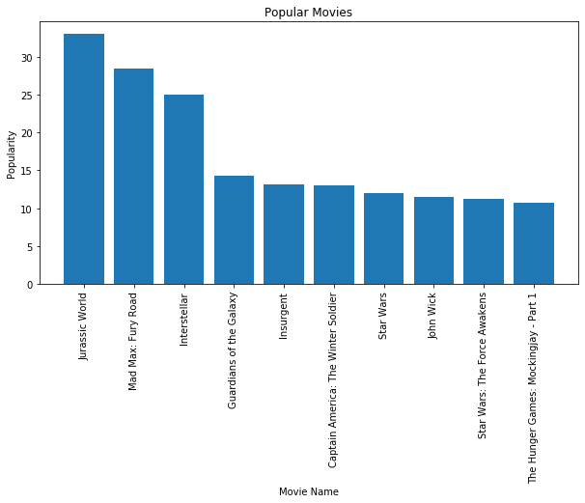
Plot Top 10 popular movies

Slide 14
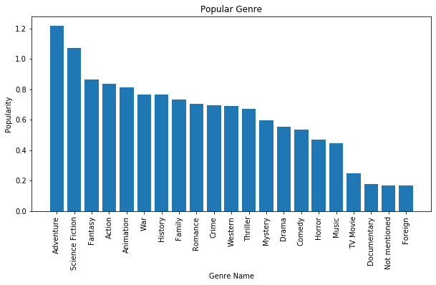
Most popular genres

Slide 15
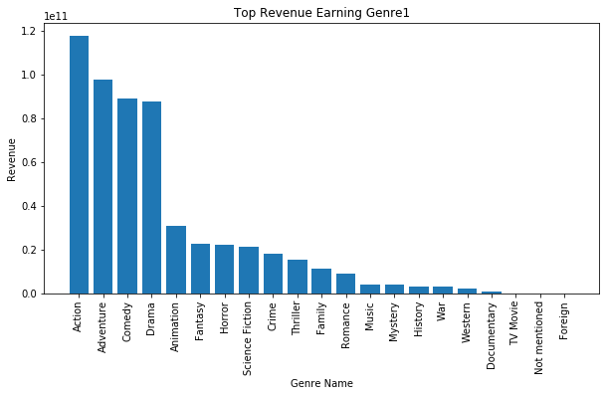
Genre1 by revenue

Slide 16
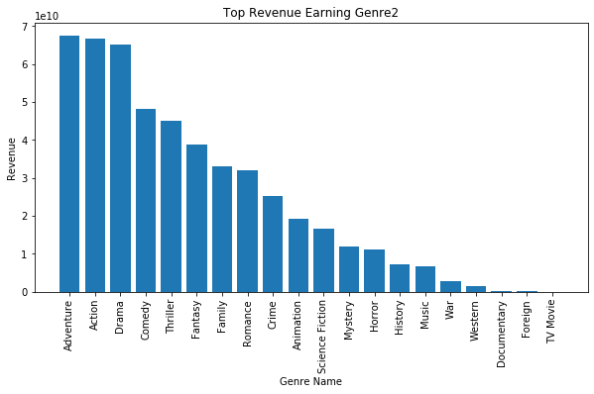
Genre2 by revenue

Slide 17
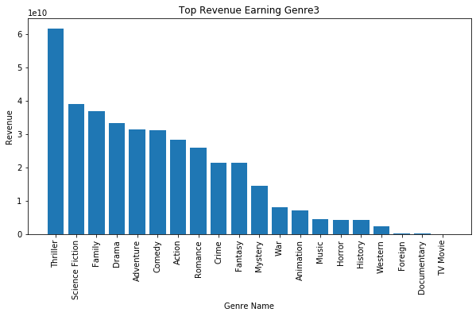
Genre3 by revenue

Slide 18
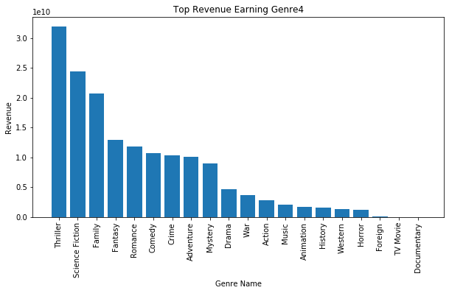
Genre4 by revenue

Slide 19
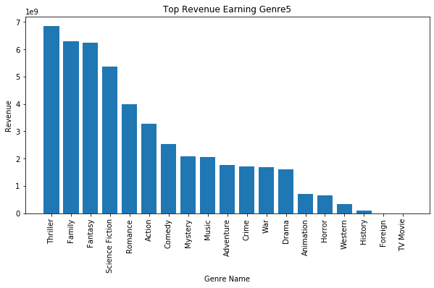
Genre5 by revenue

Slide 20
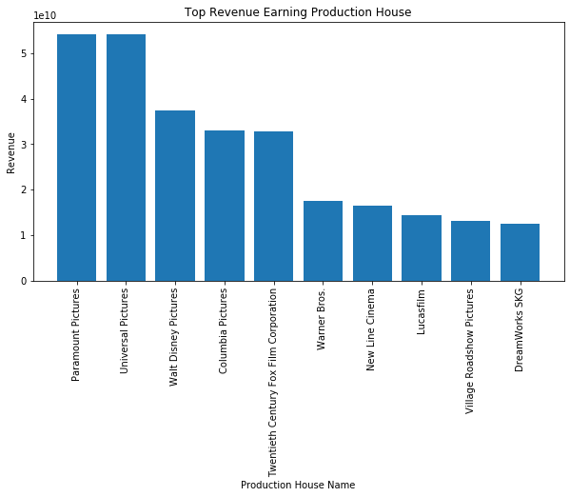
Top revenue generating production company

Slide 21
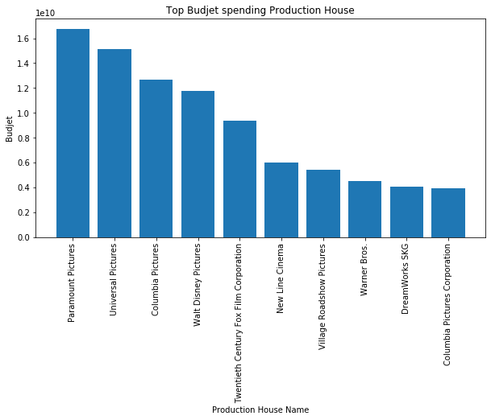
Top budget spending production company

Slide 22
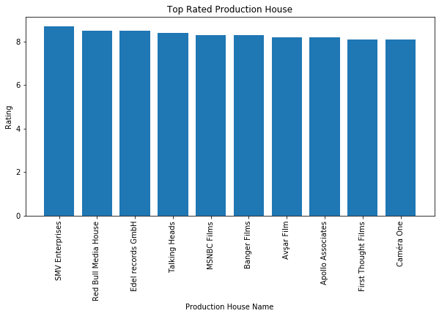
Top production company produced highest rated movies

Slide 23
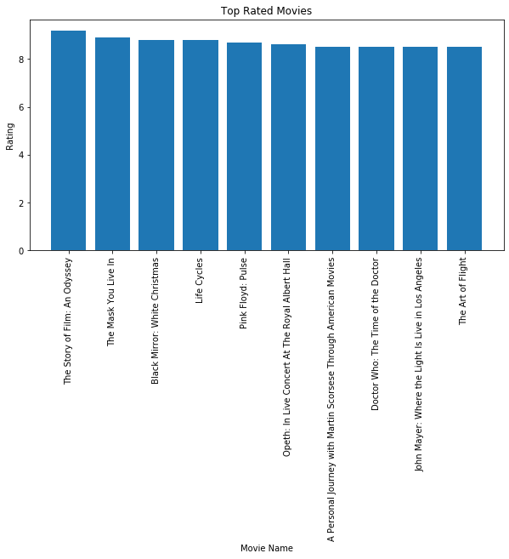
Top rated movies

Slide 24
Thank you….

